Slide 1



CARE for Teachers:
A Mindfulness-based Approach to Enhancing the Prepared Environment
Patricia (Tish) Jennings, M.Ed., Ph.D.
Second Annual VMA Conference
Saturday, October 21, 2017

Slide 3

Roadmap
Stress, Teaching & Learning
What is Mindfulness?
Mindfulness Research
  Teachers
  Students

Slide 4
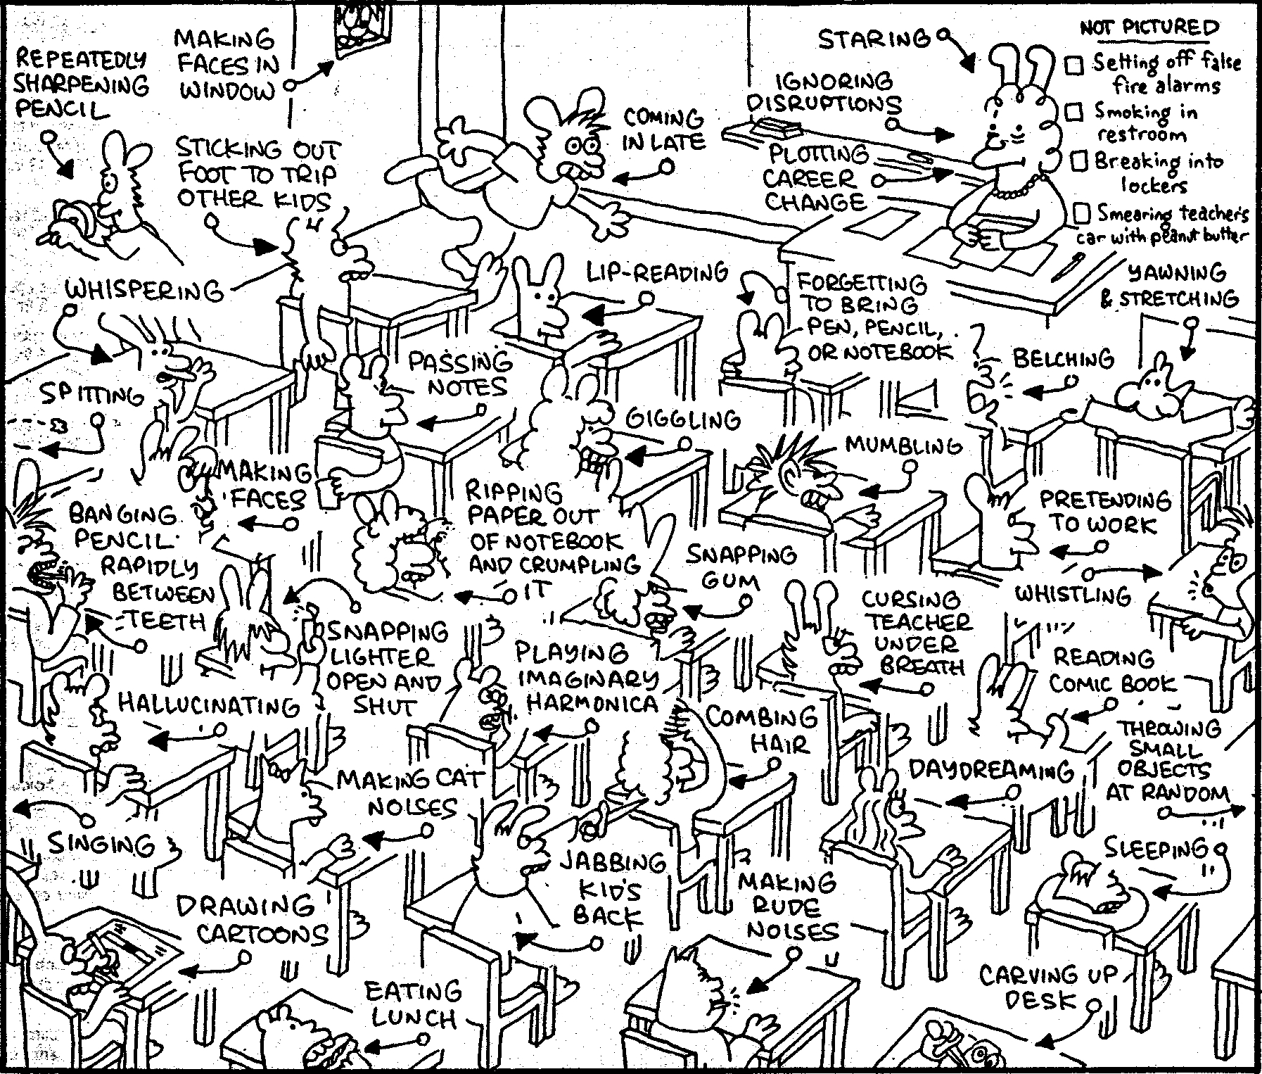
Cognitive & Emotional Demands
Notes:
However, it’s not always easy to manage the demands of teaching and provide support to all children. Talk about why the classroom is stressful but why it is so important for teachers to manage this stress so they can be exceptional models of character strengths such as patience, self-control, thoughtfulness, openness, and acceptance.

Slide 5
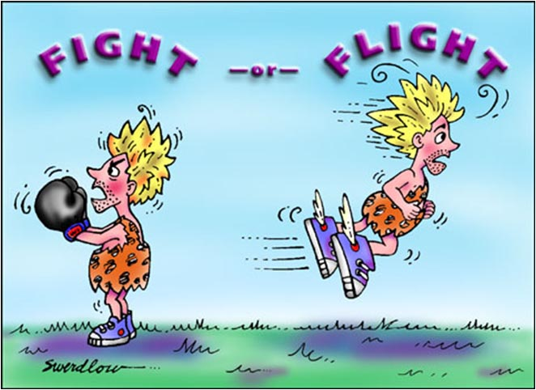
The Stress Response

Slide 6
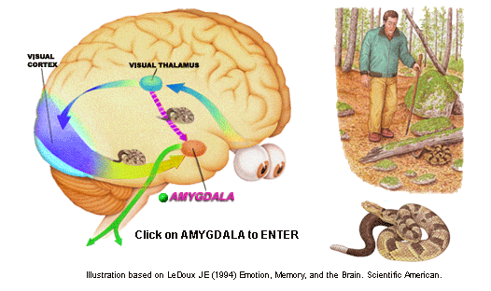

Slide 7
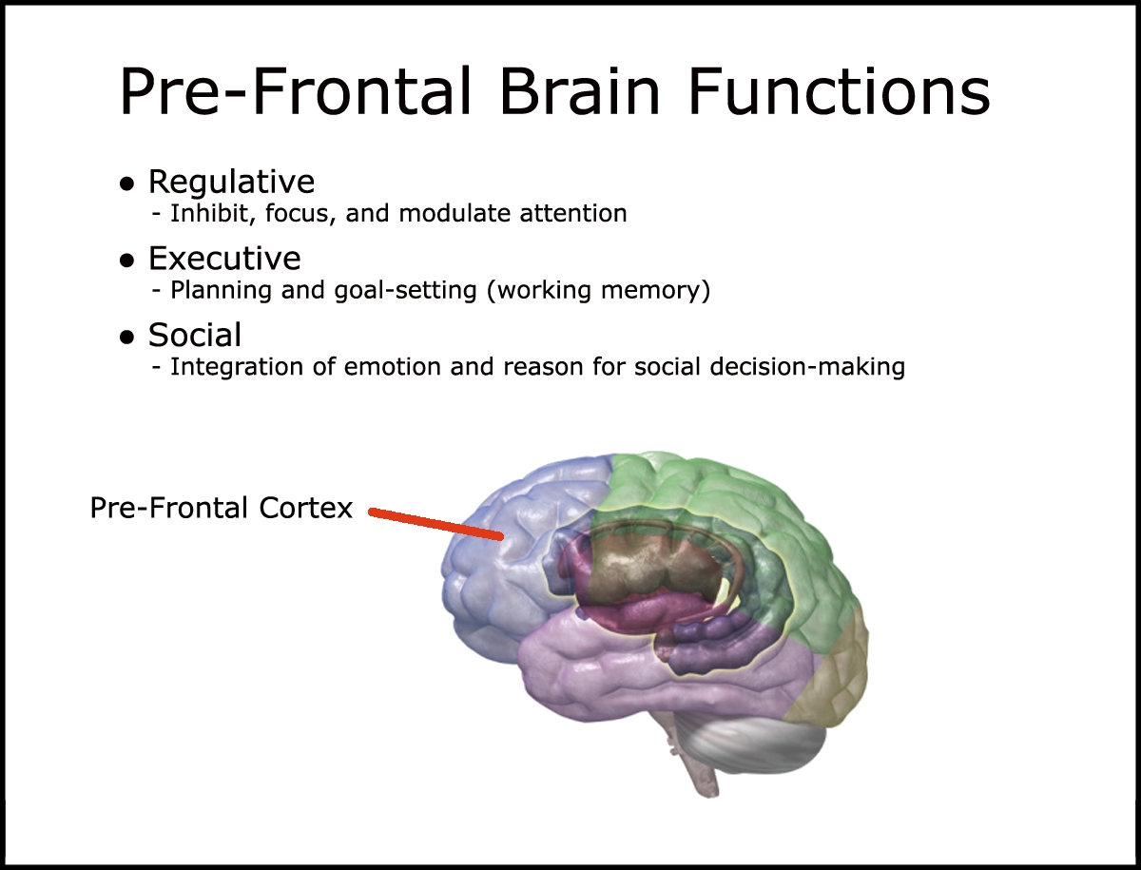

Slide 8

Real vs Psychological Threat

Slide 9
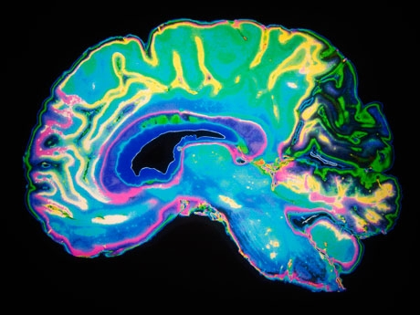
Stress and Learning
May impair the development of self-regulation
Interferes with learning
Over time may cause learning and behavior problems
Social support may be protective
Teacher stress may be “contagious” affecting student well-being and learning

Slide 10
Adaptive Function of Emotions
“Negative,” unpleasant or uncomfortable
  Trigger stress response
  Narrow focus
  Reinforce negative perception with thoughts
  Limited, conditioned reactivity
“Positive,” pleasant or comfortable
  Build resources (relationships, resilience)
  Broaden focus
  Openness, awareness of others’ perspectives and context
  Creative responses

Slide 11
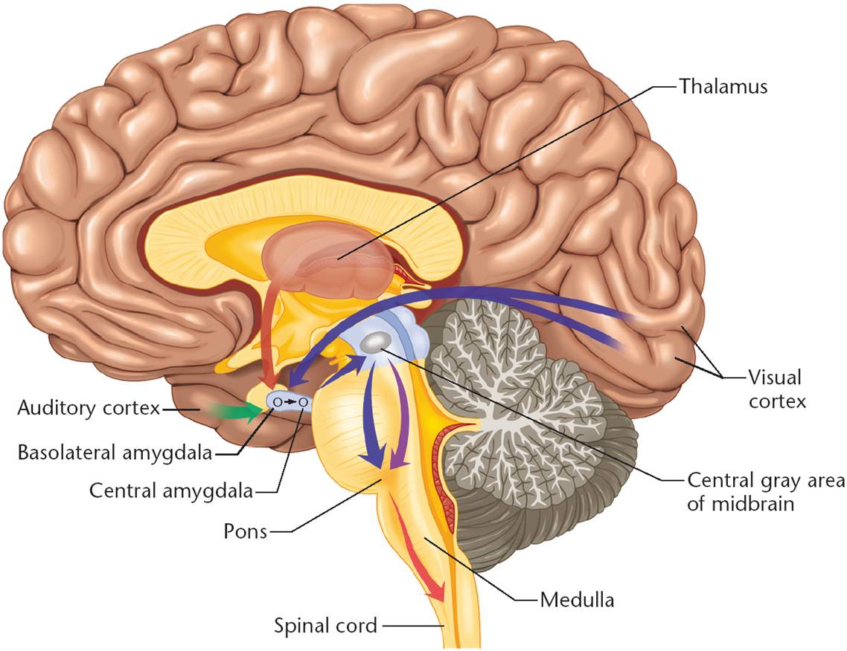
Making Connections
Helping kids
  Modeling
  Labeling
  Coaching
  Practice
Requires from adults
  Self-awareness
  Self-regulation
  Empathy, compassion, caring

Slide 12
What is Mindfulness?

Slide 13

What are Mindful Awareness or Contemplative Practices?
Formal or informal
Mindfulness
  Focused attention
  Open awareness
Caring Practices
  Focus on caring thoughts for others
Mindful walking
Body scan
Yoga – mindful movement
Tai chi and other martial arts
The arts

Slide 14
Mindfulness Research

Slide 15
Research with Adults
A growing body of research is demonstrating results:
  Enhanced memory
  Increased ability to concentrate
  Increased ability to use attention to regulate emotion
  Increased ability for empathy and compassion
  Reduced distress and increased positive affect
  Brain changes that support emotion regulation
  Davidson et al., 2003; Frederickson et al., 2008; Hölzel et al. 2008; Jha, Krompinger, & Baime, 2007; Luders et al., 2009; Lutz et al., 2008; Shapiro, Schwartz, & Bonner, 1998, Slagter, et al., 2007)

Slide 16
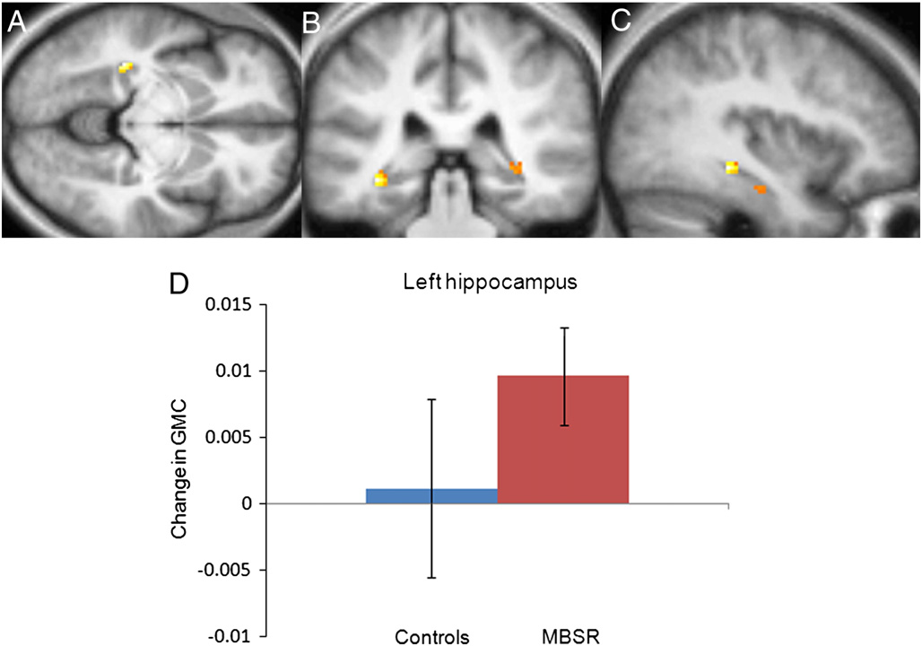
Increased density in the hippocampus after 8 weeks of MBSR compared to controls (Hölzel et al. 2008)

Slide 17

Breath Awareness Practice

Slide 18
Reflection Questions
How was that?
Were you able to recognize when your mind had wandered?
What thoughts, feelings, or sensations seemed to take your attention away from the present?
Did the experience change over time?
If so, how did it change?

Slide 19

How Can Mindfulness Help Teachers?

Slide 20

  Self Care
  Emotion Awareness
  Didactic lessons on nature of emotion
  Emotions in relation to teaching & learning
  Experiential exercises to promote emotional awareness
  Mindfulness
  Mindful awareness practices
  Mindful walking
  Empathy & Compassion for self and other
  Caring practice (metta)
  Mindful listening exercises
Applications of these to teaching through discussion and role plays

Slide 21
Among a sample of NYC teachers, mindfulness and emotion skills training resulted in reductions in psychological distress and time urgency and increases in mindfulness and healthy emotion regulation.
Observers rated CARE teachers’ classrooms as higher than controls on positive climate, teacher sensitivity, and student productivity.
Jennings, P. A., Brown, J. L., Frank, J. L., Doyle, S., Oh, Y., Tanler, R., Rasheed, D., DeWeese, A., DeMauro, A. A., Cham, H., & Greenberg, M. T. (2017). Impacts of the CARE for Teachers program on teachers’ social and emotional competence and classroom interactions. Journal of Educational Psychology. Advance online publication. http://dx.doi.org/10.1037/edu0000187

Slide 22
Positive effects of CARE were maintained or increased over 6 months for psychological distress, mindfulness and adaptive emotion regulation
Jennings, P. A., Brown, J. L., Frank, J. L., Doyle, S., Oh, Y., Davis, R., Rasheed, D., DeWeese, D. DeMauro, A. A. & Greenberg, M. T. (April, 2017). The long-term effects of the CARE for Teachers program on teachers’ wellbeing and classroom quality: Results from a randomized controlled trial. In (R. Roeser, Chair) Teacher, classroom and student impacts of teacher mindfulness programs in elementary and middle school settings. Symposium presented at the American Education Research Association Annual Conference, San Antionio, TX.

Slide 23
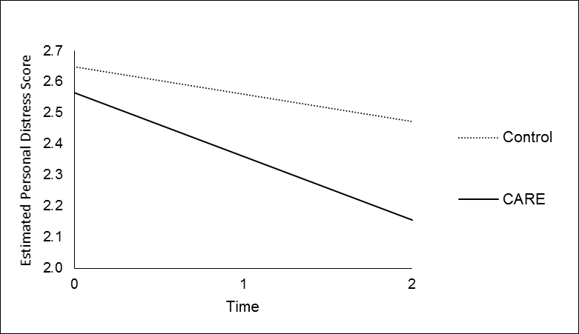
Long-term Impacts
($β$ = -0.12, $p$ < .01)
Psychological Distress

Slide 24
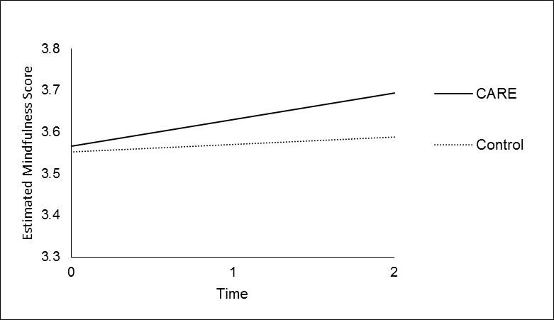
Long-term Impacts
Mindfulness
($β$ = 0.05, $p$ < .10)

Slide 25
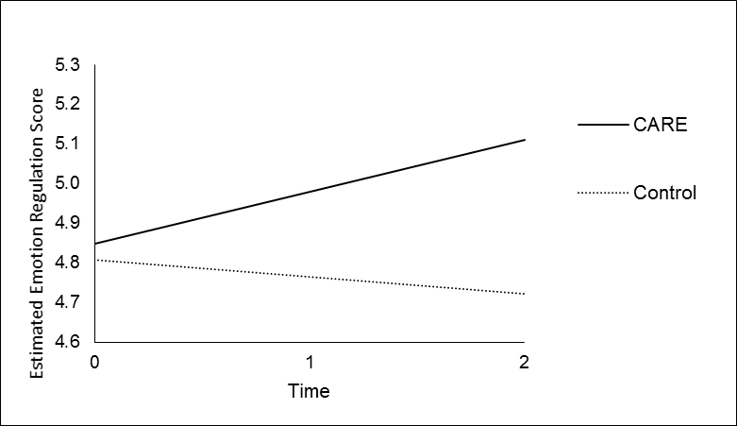
Long-term Impacts
Adaptive Emotion Regulation
($β$ = 0.18, $p$ < .001)

Slide 26
Students in CARE classrooms were rated as more engaged that students in control group classrooms
Students in CARE classrooms who were rated low in social skills improved in teacher reported reading competence
Students in CARE classrooms with teachers who were low on mindfulness at baseline improved in motivation and reading competence
Brown, J. L., Jennings, P. A., Cham, H., Rasheed, D., Frank, J. L., Doyle, S., Oh, Y., DeWeese, A. and Greenberg, M. T. (March, 2017). CARE for Teachers: Direct and mediated effects of a mindfulness-based professional development program for teachers on teachers' and students' social and emotional competencies. In (J. Downer, Chair) Social and Emotional Learning in Educational Settings Invited Symposium Role of Teacher Well-Being & Stress in the Classroom. Presented at the Society for Research on Educational Effectiveness (SREE) Annual Conference, Washington, D.C.

Slide 27

Mindfulness with Children

Slide 28

Research on School-based Programs
Evidence-based programs
  Holistic Life Foundation Yoga Programs for Youth
  Inner-Kids
  Inner Resilience Program
  Learning to Breathe
  Transformative Life Skills (Niroga Institute)
  .b Program
  MindUp
  Kindness Curriculum

Slide 29

Research on School-based Programs
Research is preliminary
Promising evidence that mindfulness-based programs
  Improve self-regulation
  Promote prosocial behavior
  Reduce distress
  May improve academic outcomes
Broderick & Frank, 2014; Frank, Bose & Schrobenhauser-Clonan, 2014; Kuyken et al., 2013; Schonert-Reichl et al., 2015

Slide 30
What More Do We Need to Know?
A lot!
Specific activities – specific outcomes?
What’s developmental appropriate? Culturally appropriate for educational settings?
Generalizability?
Brain development?
Long term academic and behavioral outcomes?

Slide 31
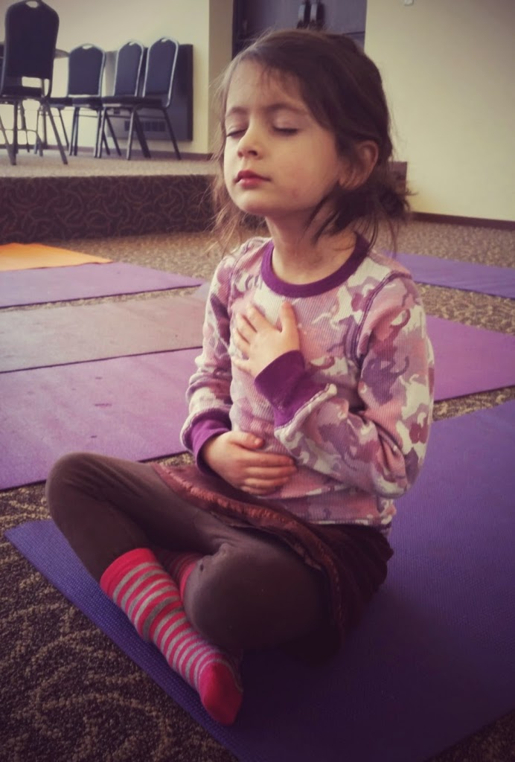
Calming & Focusing

Slide 32

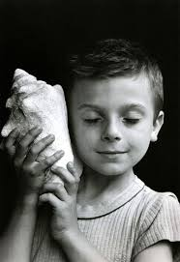
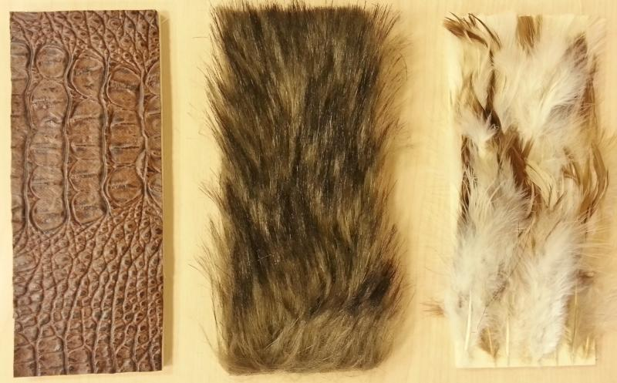
Mindful Awareness of Senses

Slide 33
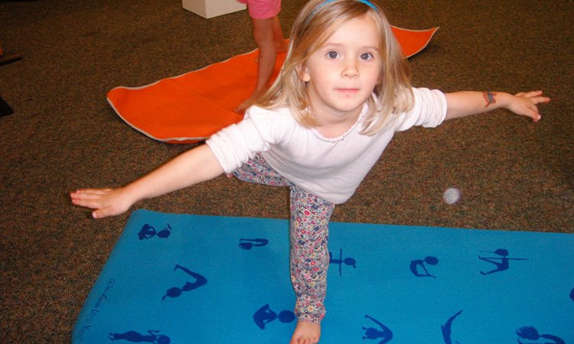

Body Awareness: Balance & Breathing

Slide 34



Other Basic Practices
Mindful walking
Mind jar
Focusing attention on nature

Slide 35
Books

Slide 36

Questions?

Slide 37
tishjennings@virginia.edu
www.TishJennings.com
https://www.facebook.com/mindfulnessforteachers/
Twitter@TishJennings

